Slide 1
Analytics Project Symposium - Fall 2016
Diagnosing Chicago’s Noises with Ubiquitous Data
Team: Lei Guo, Zhichao Yu, Jincong Zhu, Oukan Fan
Abstract: Noise pollution situation in modern cities is getting worse. People suffer from it on working efficiency and mental health. Through analytics on complaints data combining with check-ins data, traffic and POIs data, we modeled a noise map of Chicago based on noise locations. For each location, the type composition of noise complaints is also analyzed. By using MLlib in Spark, we investigated the correlations between noise complaints data and the other three datasets. Further, we filled in the missing noise complaints data, and inferred complaint counts for additional 23 areas. Finally, we derived the inferred dataset and visualized the map for noise distribution of Chicago.

Slide 2
Diagnosing Chicago’s Noises with Ubiquitous Data
Motivation
Who are the users of this analytic?
Chicago Citizens and Governments.
Who will benefit from this analytic?
Citizens who looking for quite places for study and working in Chicago, or citizens who is considering about purchasing real estate in Chicago, besides, Chicago government can take advantage of this application to monitor the noises pollution.
Why is this analytic important?
This analytic provides a more detailed and yet less expensive analytics on noise pollution in Chicago

Slide 3
Diagnosing Chicago’s Noises with Ubiquitous Data
Goodness
What steps were taken to assess the ‘goodness’ of the analytic?
In order to predict the complaints counts for areas where the complaint counts are missing/unconvincing, we derived a Linear Regression model using MLlib.
Our final model has a RMSE of 16.74. Since the data range of dataset goes from 0 to over 540, so we believe the model of our research is accurate enough for predictions of complaint counts.

Slide 4
Diagnosing Chicago’s Noises with Ubiquitous Data
Data Sources
Name: CDPH Environmental Complaints
Description: Data of 152,795 Chicago environmental complaints
Size of data: 21.5MB
Name: Points of Interests Dataset
Description: 3,680,000 records of venue data with 7 columns including venue id (Foursquare), mapped location, venue category (Foursquare), country code, etc.
Size of data: 221MB

Slide 5
Diagnosing Chicago’s Noises with Ubiquitous Data
Data Sources
Name: Check-in Dataset from Gowalla
Description: Contains total 6,442,890 check-ins worldwide collected from Gowalla in the period Feb. 2009 - Oct. 2010.
Size of data: 376MB
Name: Historical Traffic Congestion Dataset
Description: The historical estimated congestion for the 29 traffic regions in Chicago, including 3,179,966 records since Jan. 18 2013 Size of data: 239MB

Slide 6
Diagnosing Chicago’s Noises with Ubiquitous Data
Design Diagram
Platform(s) on which the analytic ran:
Dumbo on NYU HPC cluster and Quickstart VM

Slide 7
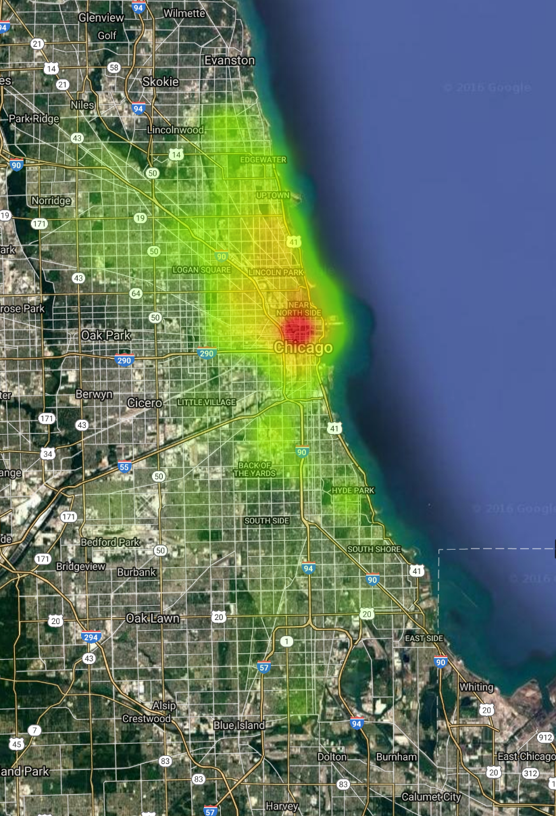
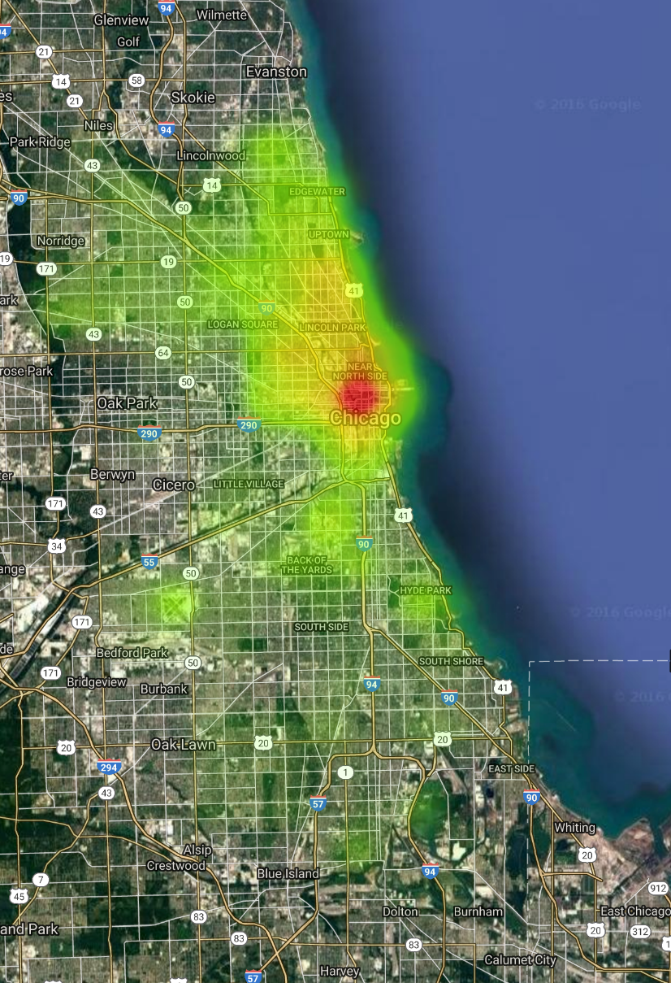
Diagnosing Chicago’s Noises with Ubiquitous Data
Results: Noise Maps
(a)Noise map without inference
(b)Noise map with inference

Slide 8
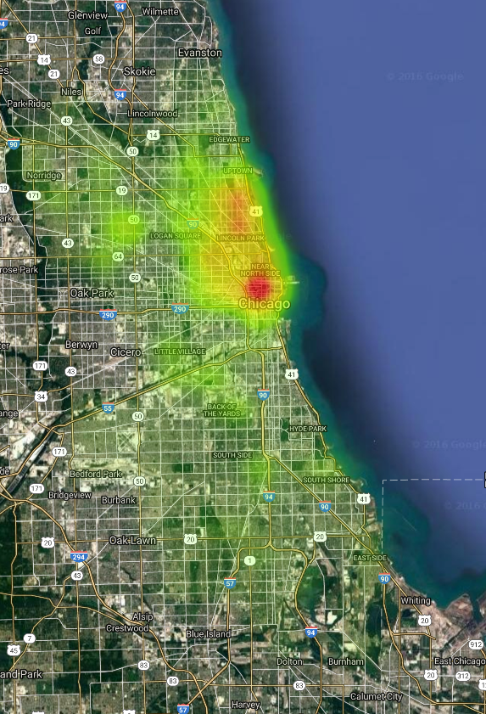
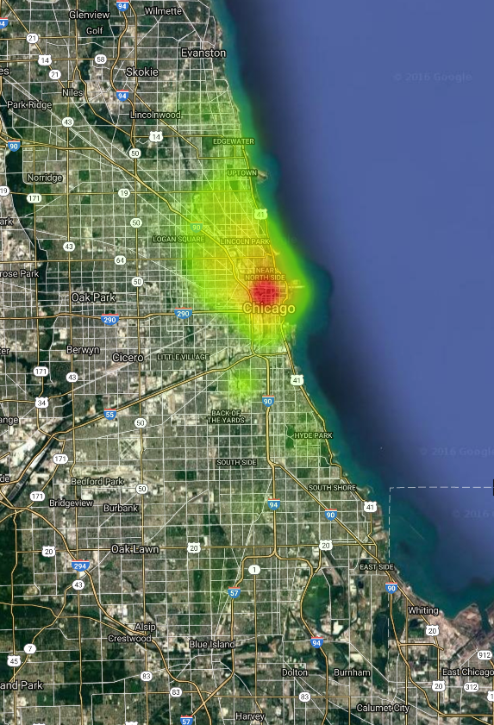
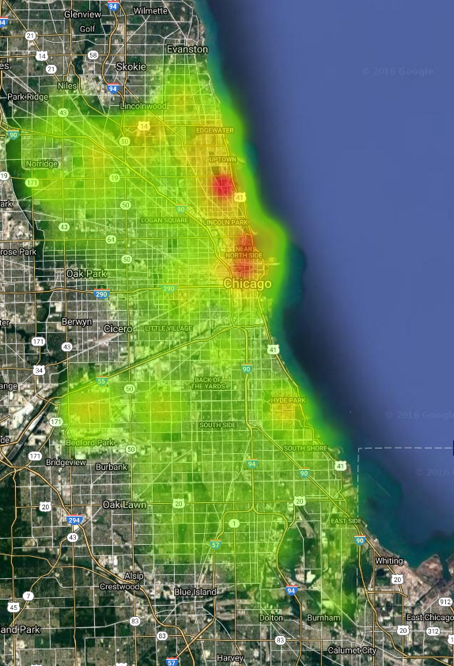
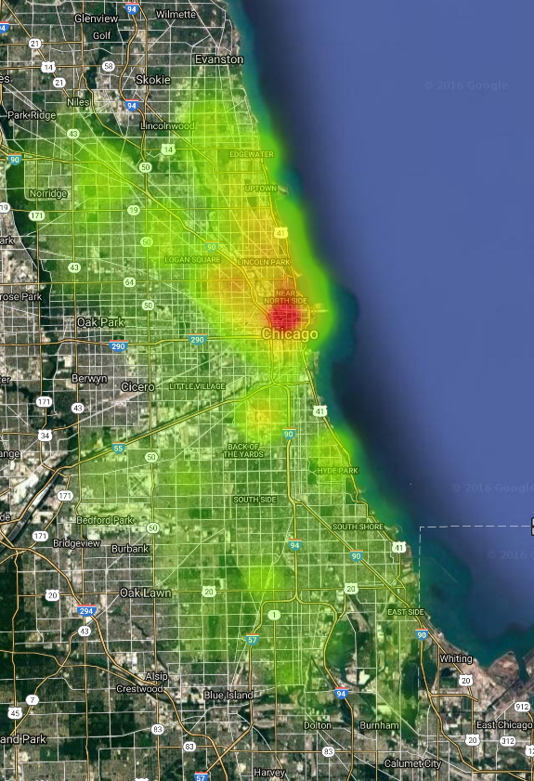
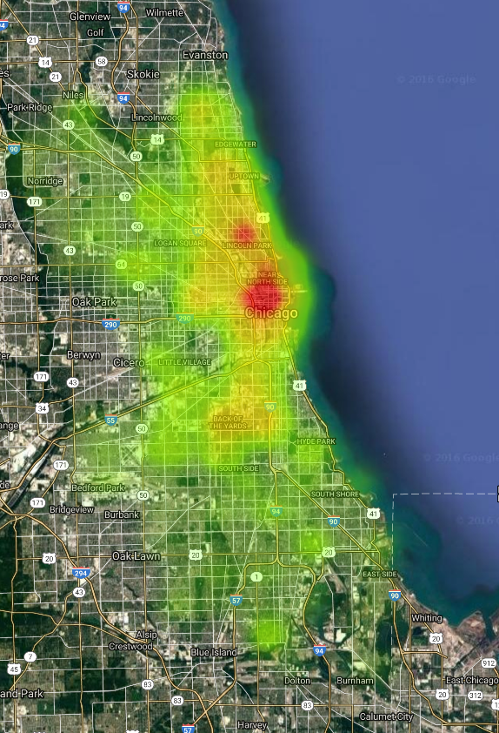
Diagnosing Chicago’s Noises with Ubiquitous Data
Results: Noise Maps of Main Types of Noises
(a) Music and Party
(b) Construction
(c) A/C and Ventilation
(d)Repair and Refurbish
(e) Traffic

Slide 9
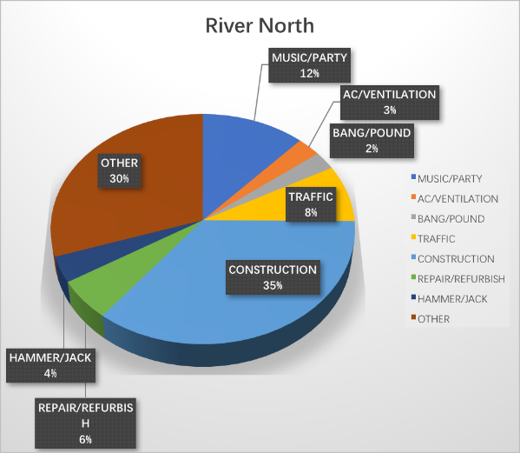
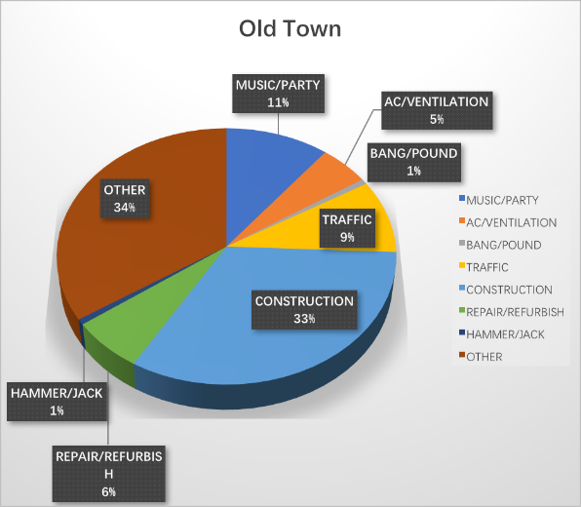
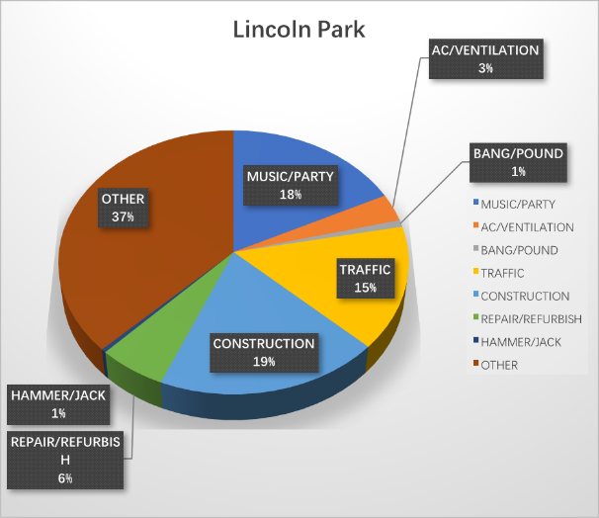
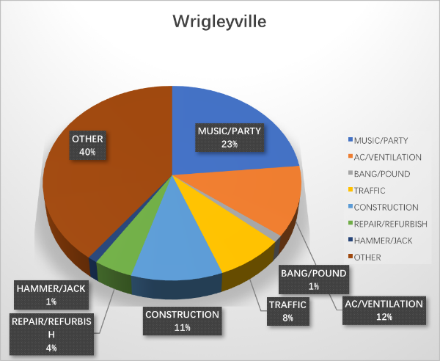
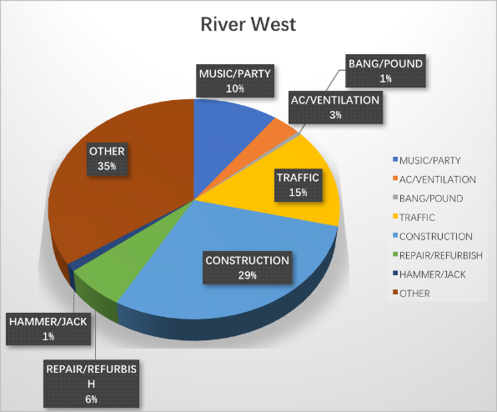
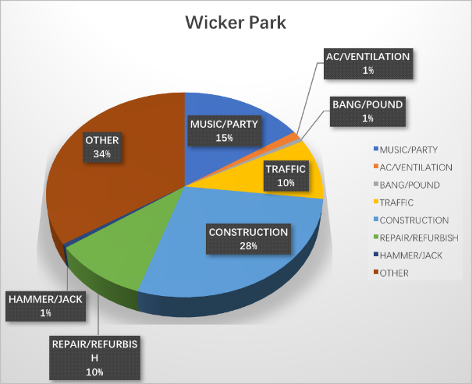
Diagnosing Chicago’s Noises with Ubiquitous Data
Results: Noise Composition of Typical Locations

Slide 10
Diagnosing Chicago’s Noises with Ubiquitous Data
Obstacles
1. Classify different types of noise complaints;
2. Implement the regression model in MLlib by using Scala in Spark.

Slide 11
Diagnosing Chicago’s Noises with Ubiquitous Data
Summary
Trough our project, a Linear Regression model has been derived for predicting noise complaint counts in areas where complaint data was missing or unconvincing. Finally, with this model, a noise distribution map of Chicago and noise type composition for each area has been obtained.
Acknowledgements
Professor:
Suzanne K McIntosh - sm4971@nyu.edu
Teaching Assistants:
Hassan Zaidi - hmz224@nyu.edu
Nirali Shah - nns271@nyu.edu
Technicians of NYU High Performance Computing - hpc@nyu.edu
Microsoft Research:
Dr. Yu Zheng - yuzheng@microsoft.com

Slide 12
Diagnosing Chicago’s Noises with Ubiquitous Data
References
[1] Lasse Korsholm Poulsen, Daan Dekkers, Nicolaas Wagenaar, Wesley Snijders, Ben Lewinsky Raghava Rao Mukkamala and Ravi Vatrapu. Green cabs vs. Uber in New York City. Big Data, IEEE International Congress on, June 2016.
[2] Jing Yuan, Yu Zheng and Xing Xie. Discovering Regions of Different Functions in a City Using Human Mobility and POIs. Proceedings of the 18th ACM SIGKDD international conference on Knowledge discovery and data mining.
[3] City of Chicago, Data Portal. https://data.cityofchicago.org/Environment-Sustainable Development/CDPH-Environmental-Complaints/fypr-ksnz
[4] T. White. Hadoop: The Definitive Guide. O’Reilly Media Inc., Sebastopol, CA, May 2012.
[5] A. Gates. Programming Pig. O’Reilly Media Inc.,Sebastopol, CA, October 2011.
[6] J. Dean and S. Ghemawat. MapReduce: Simplified data processing on large clusters. In proceedings of 6th Symposium on Operating Systems Design and Implemenation, 2004.
[7] C. Olston, B. Reed, U. Srivastava, R. Kumar, A. Tomkins. Pig Latin: A not-so-foreign language for data processing. In proceedings of SIGMOD, June 2008.
[8] I. Schweizer, R. Bartl, A. Schulz, F. Probst, M. Muhlhauser. NoiseMap - Real-time participatory noise map. In Proceedings of 2nd International Workshop on Sensing Applications on Mobile Phones (PhoneSense ’11), 2011.
[9] M. Gallo, O. Mascolino, G. Mazza. A Model for Estimating Road Traffic Noise in Urban Areas. Environment and Electrical Engineering, IEEE 16th International Conference on, June 2016
[10] Jitao Sang, Tao Mei, Jian-Tao Sun, Changsheng Xu, Shiping Li. Probabilistics Sequential POIs Recommendation via Check-In Data. Proceedings of the 20th International Conference on Advances in Geographic Information Systems, 2012.
[11] Piotr Mioduszewski, Jerzy A. Ejsmont, Jan Grabowski, Daniel Karpin´ ski. Noise map validation by continuous noise monitoring. Applied Acoustics, Elsevier, 2011.
[12] Hsun-Ping Hsieh, Tzu-Chi Yen, Cheng-Te Li. What Makes New York So Noisy?: Reasoning Noise Pollution by Mining Multimodal Geo-Social Big Data. Proceedings of the 23rd ACM international conference on Multimedia, 2015.
[13] Yilun Wang, Yu Zheng, Tong Liu. A Noise Map of New York City. Proceedings of the 16th ACM International Conference on Ubiquitous Computing, 2014.

Slide 13
Diagnosing Chicago’s Noises with Ubiquitous Data
Thank you!

